Slide 1
Data Analysis Report
Project 2
Danlei Qian
Apri 6，2019

Slide 2

Date Sources
Community Health Status Indicators (CHSI) to Combat Obesity, Heart Disease and Cancer
Link:
https://catalog.data.gov/dataset/community-health-status-indicators-chsi-to-combat-obesity-heart-disease-and-cancer

Slide 3
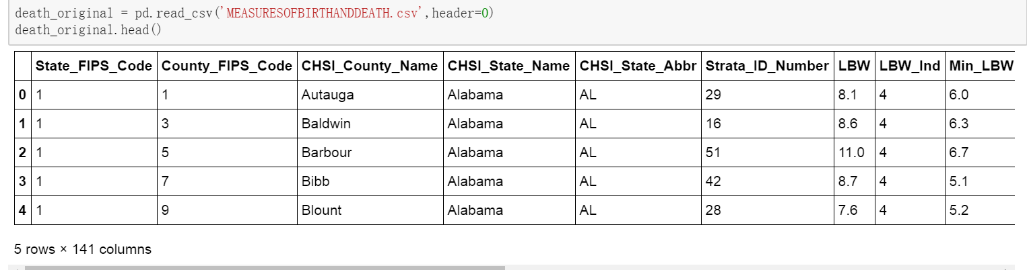
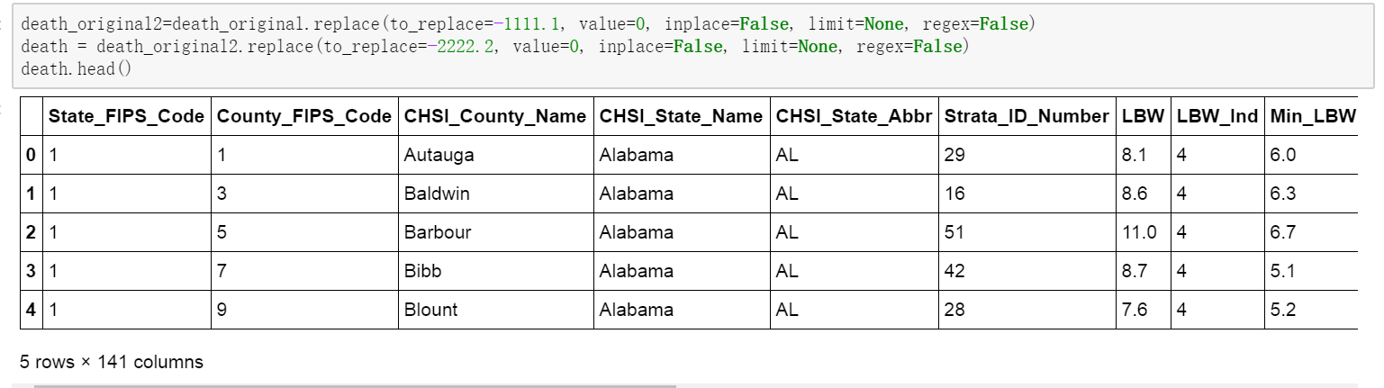
Data Cleaning and Preprocessing
STEP 1
Original file
df.replace
-1111&-2222

Slide 4
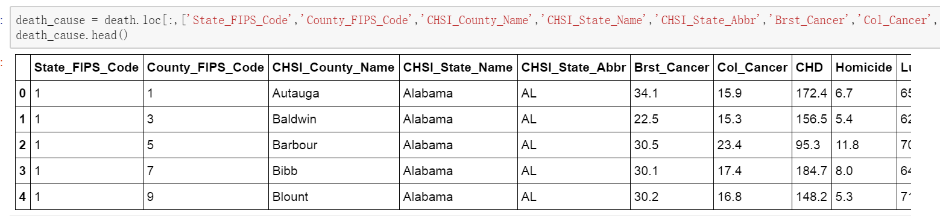
Data Cleaning and Preprocessing
STEP 2
df.loc

Slide 5
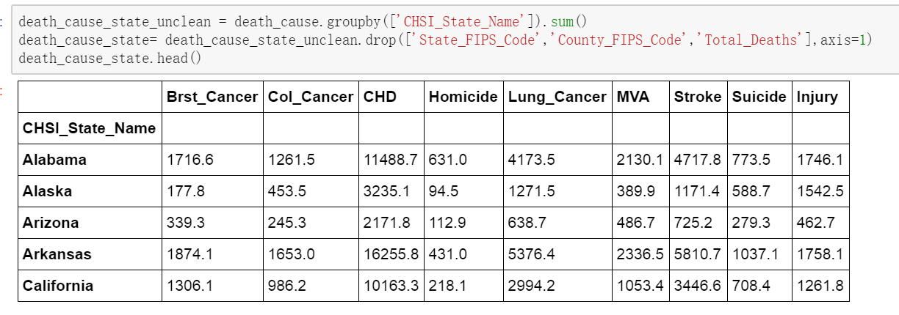
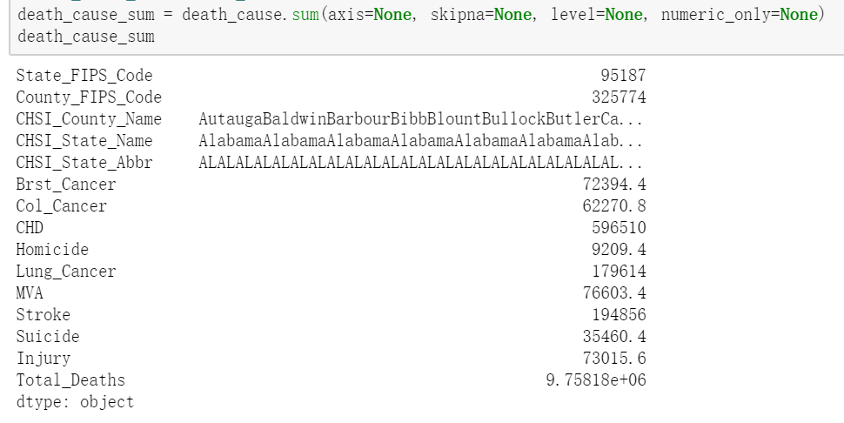
Data Cleaning and Preprocessing
STEP 3
df.groupby
df.drop
df.sum

Slide 6
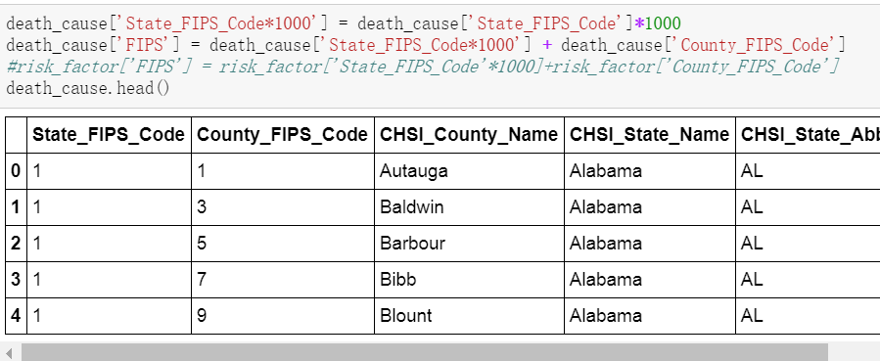

Data Cleaning and Preprocessing
STEP 4
Get the combined FIPS code

Slide 7
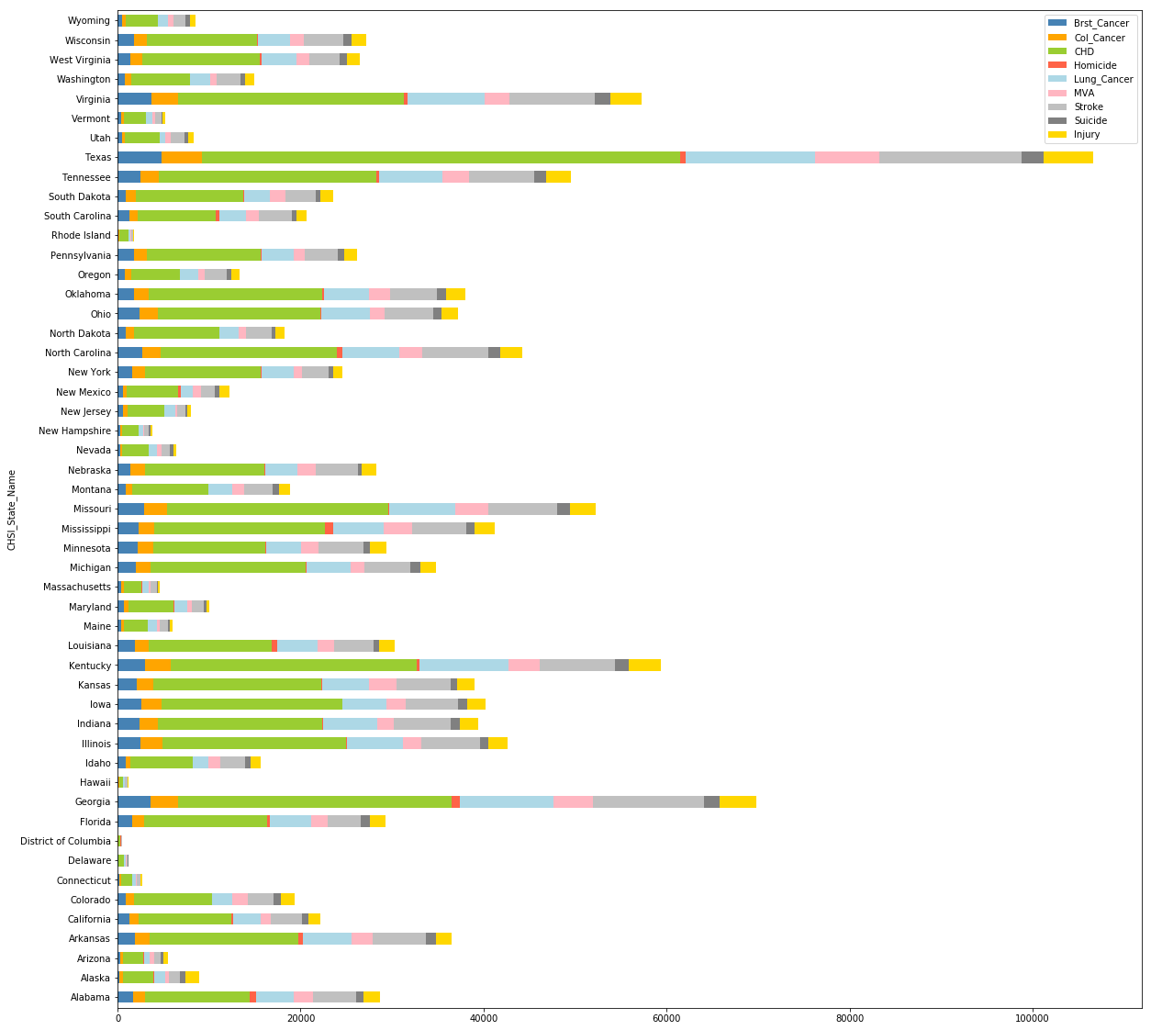
Data Analysis Ⅰ
1.0 Compare the leading causes of death between states

Slide 8
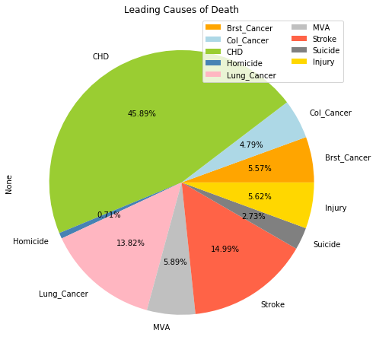
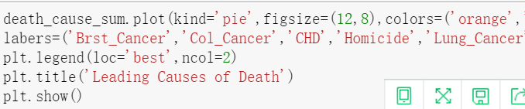
Data Analysis
2.0 Compare the total death number of leading causes

Slide 9
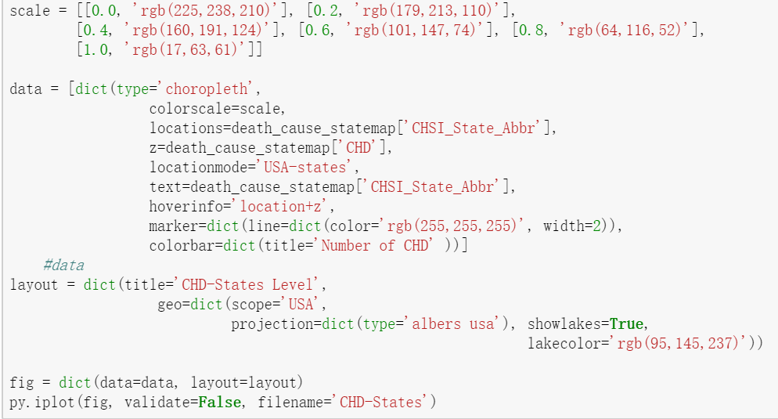
Data Analysis Ⅰ
3.0 Distribution of death resulted from leading causes from STATE level
Stroke
Coronary heart disease
Lung cancer

Slide 10
Data Analysis Ⅰ
3.0 Distribution of death resulted from leading causes

Slide 11
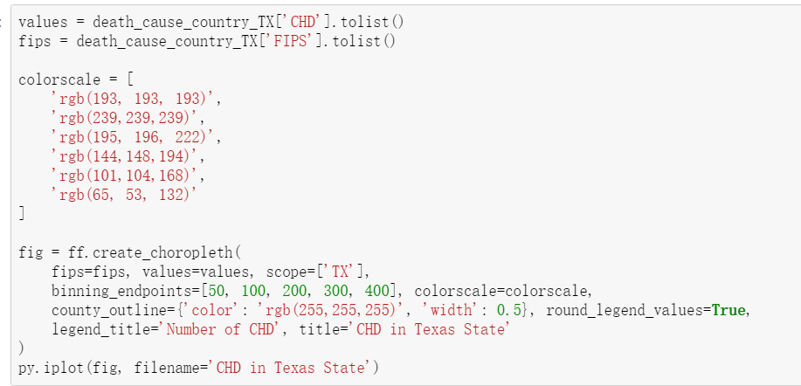
Data Analysis Ⅰ
4.0 Distribution of death resulted from leading causes from COUNTY level

Slide 12
Data Analysis Ⅰ
4.0 Distribution of death resulted from leading causes from COUNTY level
Stroke
Coronary heart disease
Lung cancer

Slide 13
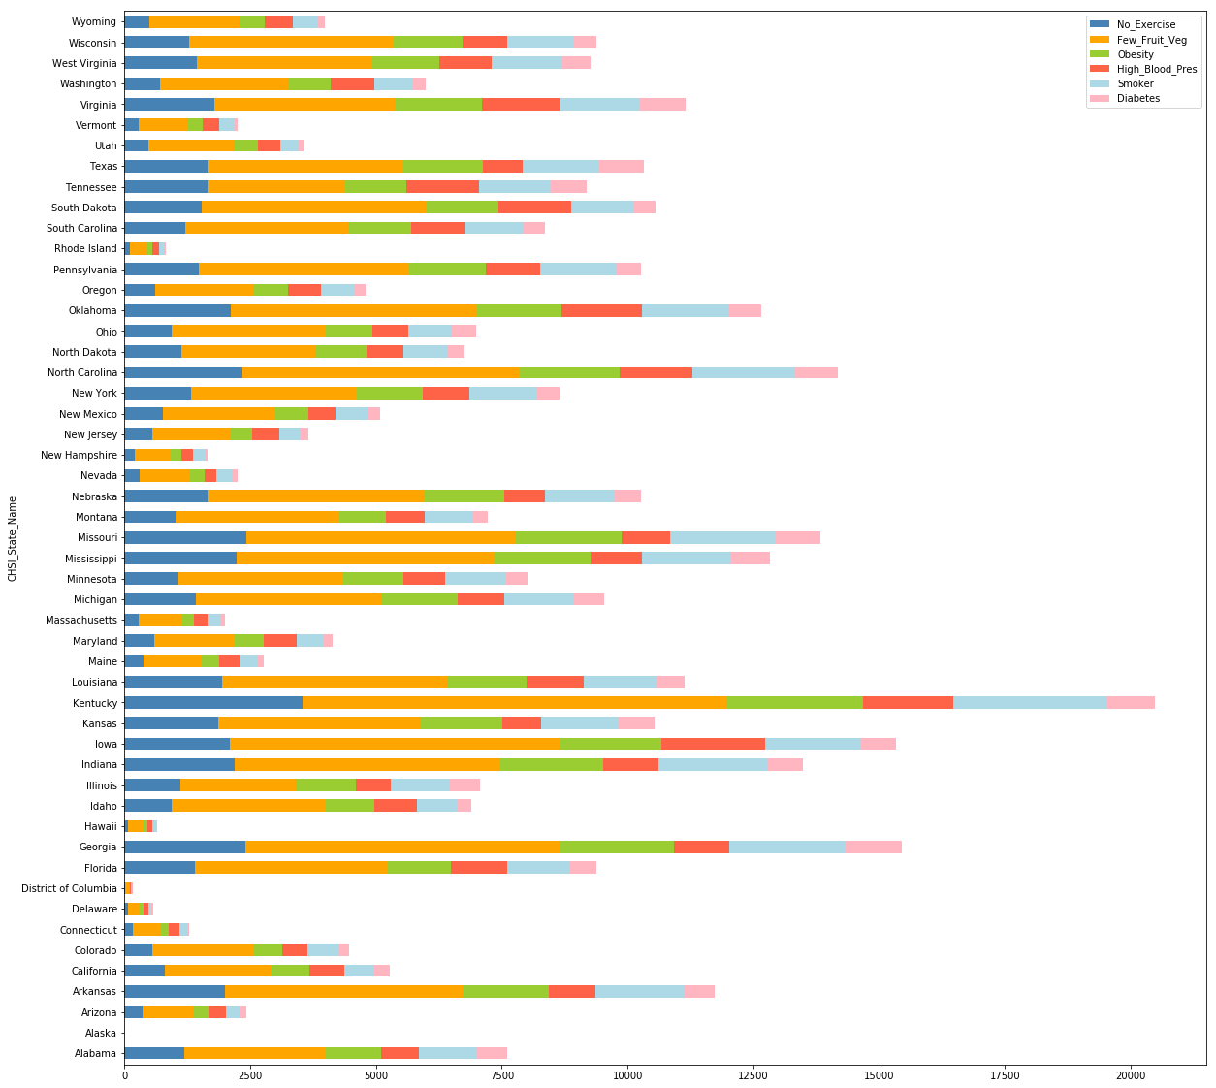
Data Analysis Ⅱ
1.0 Compare the risk factors of death between states.

Slide 14
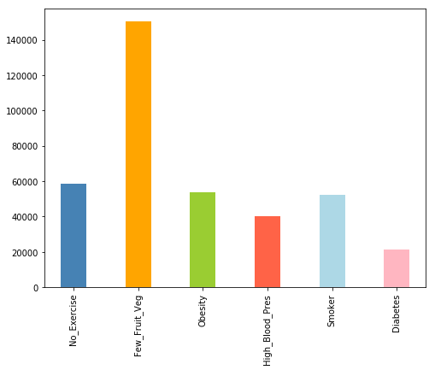
Data Analysis Ⅱ
2.0 Compare the total numbers of people with risk factors

Slide 15
Data Analysis Ⅱ
3.0 Distributions of risk factors from State and County level

Slide 16
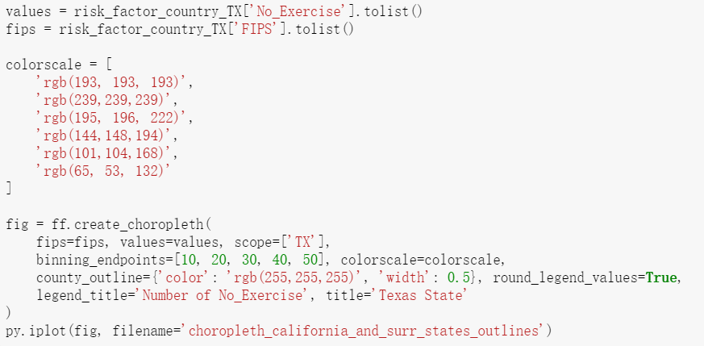
Data Analysis Ⅱ
4.0 Relationship between leading causes of death and risk factors of death

Slide 17
Data Analysis Ⅱ
4.0 Relationship between leading causes of death and risk factors of death

Slide 18

Conclusion
Coronary heart disease is the most leading causes of death .
Eating few fruit and vegetables is the main risk exiting in people’s health.
People in Texas need to pay full attention to their health status.
In general, both risk factors may contribute to unnatural death.
Keep Healthy!

Slide 19
Thanks!

